Slide 1
CMPSC 100
Computational Expression

Slide 2

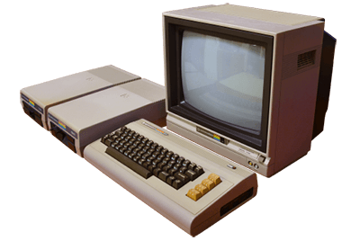




GitHub
Your PC
GitHub
“Working” directory

Slide 3
Head to our course GitHub
Link is in the Slack #activities channel
Find the “class-activities” repository
“Clone” the repository to a easily-accessible, easy-to-remember location.
For example, to your ~ (“Home”) directory or
Desktop
For Mac users: ~/Desktop
For (some) Windows users, either:
~/Desktop
~/OneDrive/Desktop

Slide 4
Renders an element unique and immutable
Makes an element visible to other programs
Indicates that there is no return type
public class HelloWorld {
public static void main(String[] args) {
// This is a comment. Does it display?
System.out.println("Hello, World!");
}
}
Parameter
Method call; reference to the java.lang library
Parameter

Slide 5
Reserved words
In HelloWorld.java, the reserved words are:
public
HelloWorld
static
void
main
args
System
out
println

Slide 6
Have a look over the source code of both HelloWorld.java and GreetWorld.java
What do you expect the output of GreetWorld.java to be?
How do you know?
Run the following commands to verify:
javac HelloWorld.java –d .
javac GreetWorld.java
java GreetWorld

Slide 7
package greetings;
public class HelloWorld {
public static String say(){
return "Hello, World!";
}
public static void main(String[] args) {
System.out.println(say());
}
}

Slide 8
package greetings;
public class HelloWorld {
public static String say(){
return "Hello, World!";
}
public static void main(String[] args) {
System.out.println(say());
}
}

Slide 9
package greetings;
public class HelloWorld {
public static String say(){
return "Hello, World!";
}
public static void int main(String[] args) {
System.out.println(say());
}
}

Slide 10
Adding Keys
Don’t forget to add your keys to your session so that you can “clone” from GitHub
In a terminal session, do the following:
Check if you already have a key loaded: ssh-add –l
If you receive a response beginning with “4096 SHA256,” your key is loaded
eval “$(ssh-agent –s)”
ssh-add ~/.ssh/id_rsa

Slide 11
Lab file management
Change directories (“cd”) to your desktop:
For Mac users, this is likely ~/Desktop
For Windows users, this is likely:
~/OneDrive/Desktop
~/Desktop
Make a directory called “CMPSC100” (“mkdir” or visually)
Change directories to this new location (“cd”)
Clone the repository

Slide 12
Lab copy corrections
You are looking for DisplayPoem.java
The actual Docker command for GatorGrader container is in the #labs channel

